Slide 1
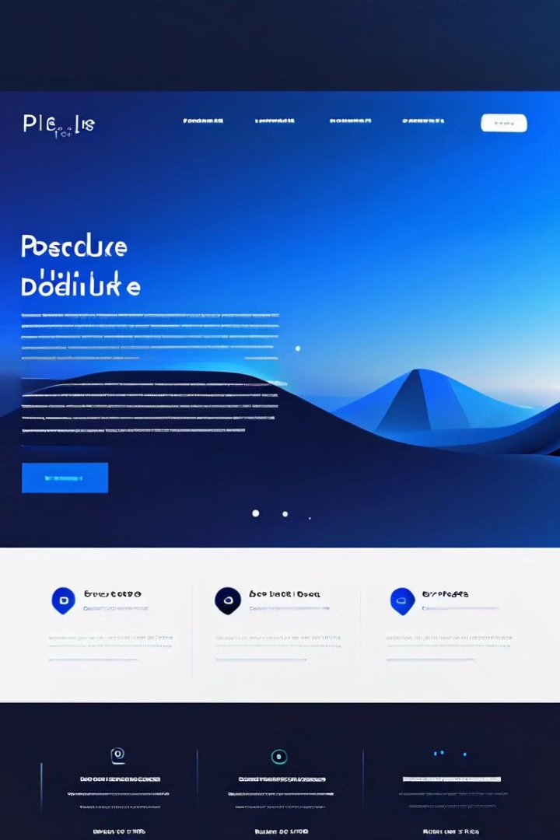
PDF Text Extraction Made Easy
No more struggling with messy PDF formatting or language barriers. Our cloud-based PDF text extractor provides a seamless solution to effortlessly extract Chinese and English text from any PDF file.
Author: Hang Tian Yunkai Yao

Slide 2

Streamlined PDF Handling
1
Simple Upload
2
Language Detection
3
Flexible Output
Quickly upload your PDF files with just a few clicks.
Our advanced algorithms automatically identify and separate Chinese and English text.
Choose to export the extracted text as a Microsoft Word document or plain text.

Slide 3
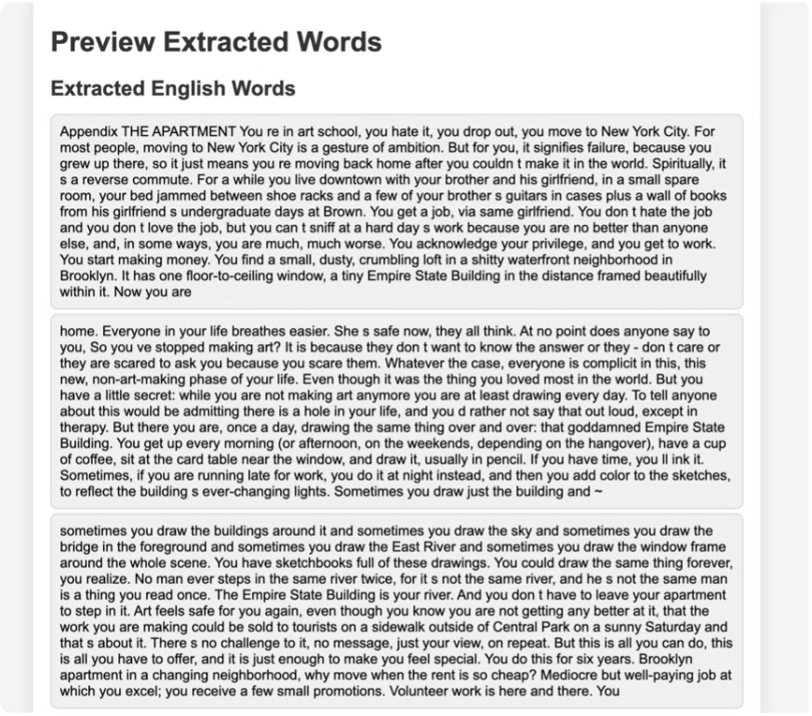
Powerful Extraction Engine
1
OCR Technology
2
Language Processing
3
Formatting Cleanup

Slide 4
Seamless Integration
Cloud Compatibility
Productivity Integration
Workflow Automation
Our service seamlessly integrates with popular cloud storage platforms, making it easy to access and manage your extracted text.
The exported text can be directly imported into Microsoft Word, Google Docs, or other word processing software for further editing and collaboration.
Automate your PDF text extraction process and streamline your workflows with our powerful API and integration capabilities.

Slide 5




Get Started Today
Sign Up
Upload PDF
Extract Text
Create your free account to start using our PDF text extractor service.
Drag and drop your PDF files or browse to select them for processing.
Watch as our powerful engine extracts and organizes the Chinese and English text from your PDFs.

Slide 6
Utilizing cloud technology and Microsoft Azure virtual machines
Project Kernel and Module
We utilized an Optical Character Recognition (OCR) kernel for our project, employing the Python module "pdfplumber" to extract text from PDF documents. This tool enabled us to accurately convert scanned documents into editable and searchable text formats. By leveraging "pdfplumber," we were able to automate the text extraction process, significantly enhancing our workflow efficiency and data usability.
We leveraged cloud technology by utilizing virtual machines (VMs) on Microsoft Azure. This setup allowed us to scale our resources dynamically, providing the flexibility to manage our OCR tasks efficiently. By hosting our operations on Azure, we ensured robust security and reliability, enabling seamless processing of large datasets in the cloud.

Slide 7
Thank You!

